Slide 1
CGPA Calculator
Group 7 :
Abu Bakar Bin Ahmad Bashir A18CS3O4O
Muhammad Faris Bin Abd Mutalib A18CS3O53
Muhammad Zuhair Bin Mohd Dzahari B18CSOO17
[ UTM Student’s Academic Transcript ]

Slide 2
What our system is about ? ..
The UTM Student’s Academic Transcript is an interactive CGPA calculator program which is intended for the Universiti Teknologi Malaysia’s community to ease the way for calculate the GPA and CGPA of each semester on real time.
With the minimalist user interface together with user-friendly features, this system would bring out the exact result for each student’s cumulative grade point average based on their achievement from the subjects in particular semester.

Slide 3
What our system can do ? ..
The system be able to calculate both the GPA and CGPA based on the input from the students/user (which are the credit hours + pointers for each of the subjects) and display the final CGPA together with their name and matric number.
The system be able to retrieve the data from the user and give the output in the text file for easy the users to print out once the calculation is done.

Slide 4
Who are our target users ? ..
UTM Undergraduate Student’s ( e.x Bachelors of Computer Science)
The UTM Students, with primarily focused on the Faculty of Computing and Bachelor of Computer Science (SCSR) can calculate their CGPA on real time.
Academic Advisor’s
Academic advisors can calculate the CGPA of their assigned student under their supervision, where the marks obtained from the respective lecturers.
Academic Office from the Faculty
The academic office shall help the students to obtain their final CGPA print out the results in a hard copy for the office verification.

Slide 5
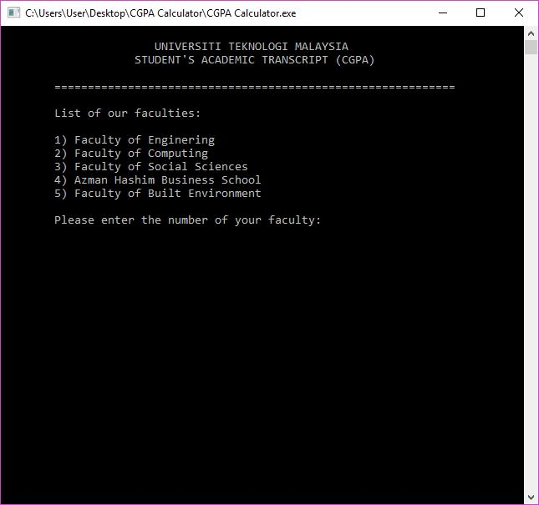
How does our system works ? ..

Slide 6
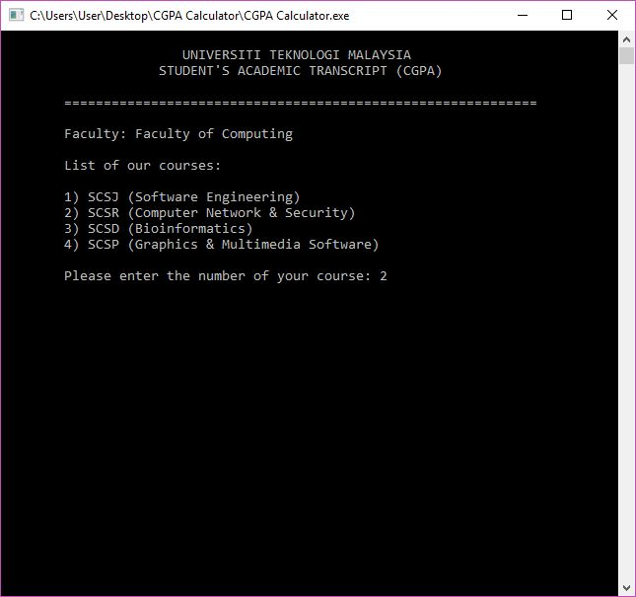

Slide 7
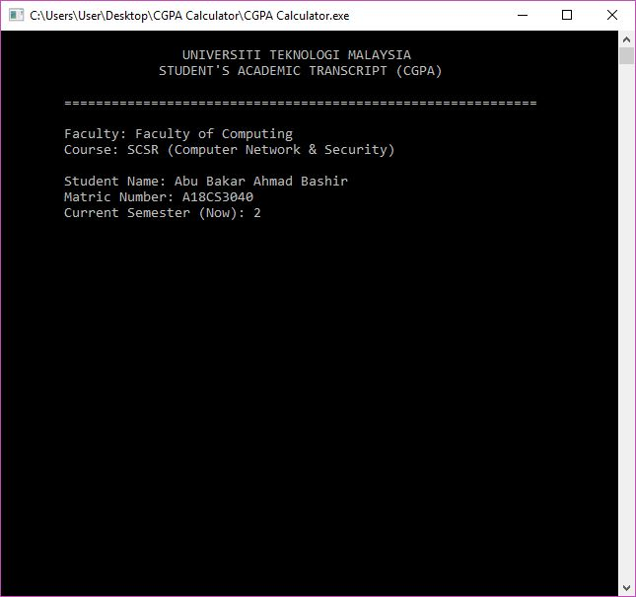

Slide 8
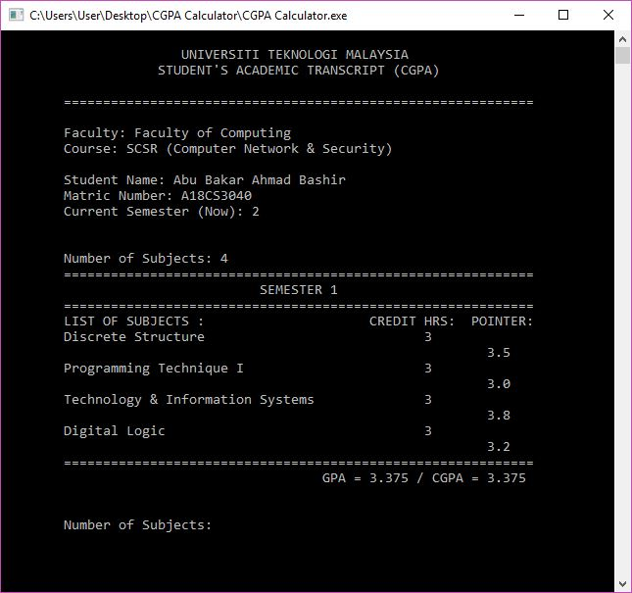

Slide 9
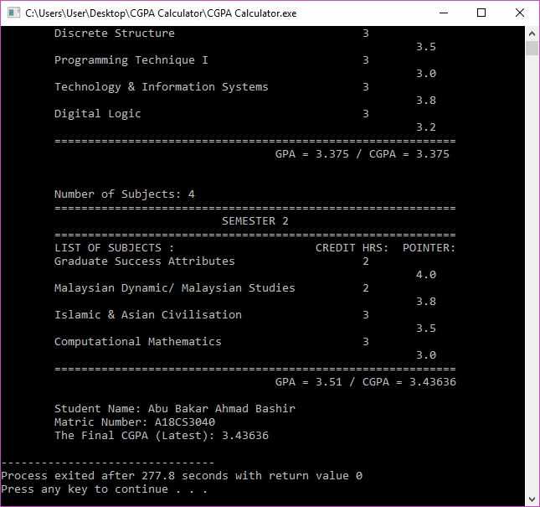

Slide 10
